Slide 1
Improving Machine Learning Models

Slide 2
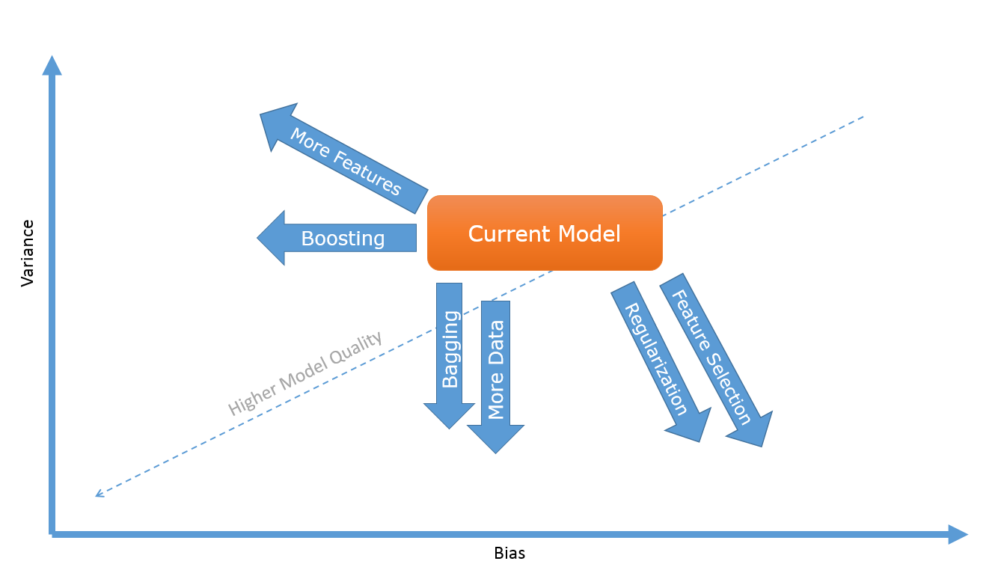
Improving Machine Learning Models

Slide 3
Bias and variance
Bias and variance are the two components of imprecision in predictive models
In general there is a trade-off between them
So normally reducing one tends to increase the other.
Bias in predictive models means that model is not capturing all the signal it could.
Bias is also known as under-fitting.
High variance models tend to perform very well on some data points and really bad on others.
This is also known as over-fitting
It means that model is too flexible for the amount of training data you have and ends up picking up noise in addition to the signal, learning random patterns that happen by chance and do not generalize beyond your training data.

Slide 4
Detect Bias / Variance
High Variance:
If your model is performing really well on the training set, but much poorer on the hold-out set
High Bias:
If your model is performing poorly on both training and test data sets, it is suffering from high bias.

Slide 5
Techniques to bring your model where you want it to be
Depending on the performance of model and whether it is suffering more from high bias or high variance, you can resort to one or more of these seven techniques to bring your model where you want it to be:
Add More Data
Add More Features
Do Feature Selection
Use Regularization
Bagging
Boosting
Use a more different class of models

Slide 6
Which method is to use when?
Technique | When to use?
Add More Data | High Variance / Overfitting
Add More Features | High Bias / Underfitting
Do Feature Selection | High Variance / Overfitting
Use Regularization | High Variance / Overfitting
Bagging | High Variance / Overfitting
Boosting | High Bias / Underfitting
Use a more different model | If our data-set is suitable to some different kind of model, then chose that model.

Slide 7
Lets see this diagram again

Slide 8
Thanks

